Slide 1
ISONE OSW Analysis
Last updated: 8/26/2023 by Jack Ruzekowicz

Slide 2
UCS brand colors for graphics/charts
Additional info in notes section
R: 203
B: 44
G: 48
R: 255
B: 82
G: 43
R: 255
B: 0
G: 147
R: 255
B: 198
G: 0
R: 255
B: 233
G: 0
theme color
R: 110
B: 200
G: 41
R: 187
B: 220
G: 0
R: 48
B: 68
G: 181
R: 0
B: 122
G: 165
R: 0
B: 174
G: 239
theme color
theme color
theme color
theme color
Notes:
These are UCS’s ten brand colors (not including black and shades of gray).
Do not use them for text (not as much contrast as white) except as an accent.
Do use them for graphics, accents, and other visual elements.
Orange, dark green, indigo, medium blue, and cyan are used as accent colors for UCS publications. These colors are also provided as Microsoft Office palette files to get you partway to using UCS colors in your project. R/G/B values for additional UCS colors are provided in this slide.
To install the UCS color palettes onto your computer, save the files in the following folder (note that you may need to enable seeing hidden folders the directories):
Windows - C:\Users\[your name]\AppData\Roaming\Microsoft\Templates\Document Themes\Theme Colors
Mac – Library\Group Containers\Office\User Content\Themes\Theme Colors
You may need to restart your Microsoft Office programs in order to begin seeing the new palettes. Contact Cynthia if you need assistance installing these files.

Slide 3
Notebook 1: Winter OSW Analysis

Slide 4
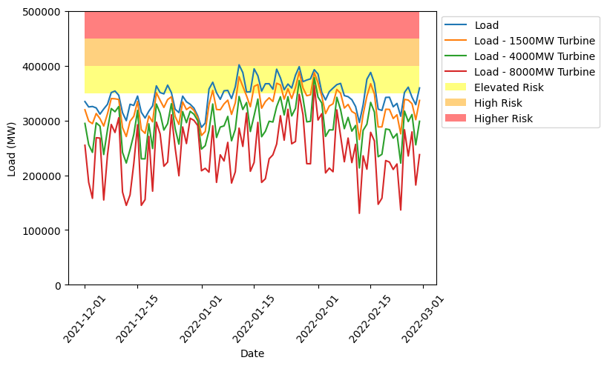
Winter 2021-2022 Load and Loads after Theoretical OSW Installations

Slide 5
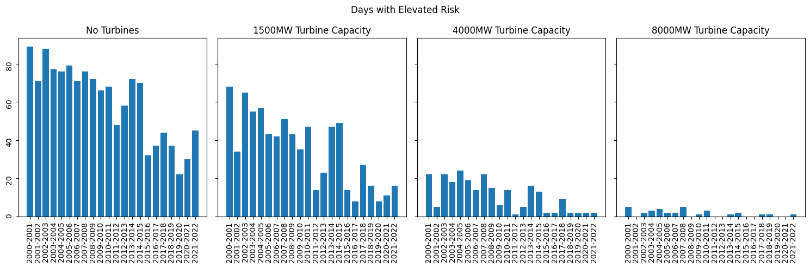
Days of Elevated Risk with Varying Levels of OSW Capacity for Winters 2000 to 2022

Slide 6
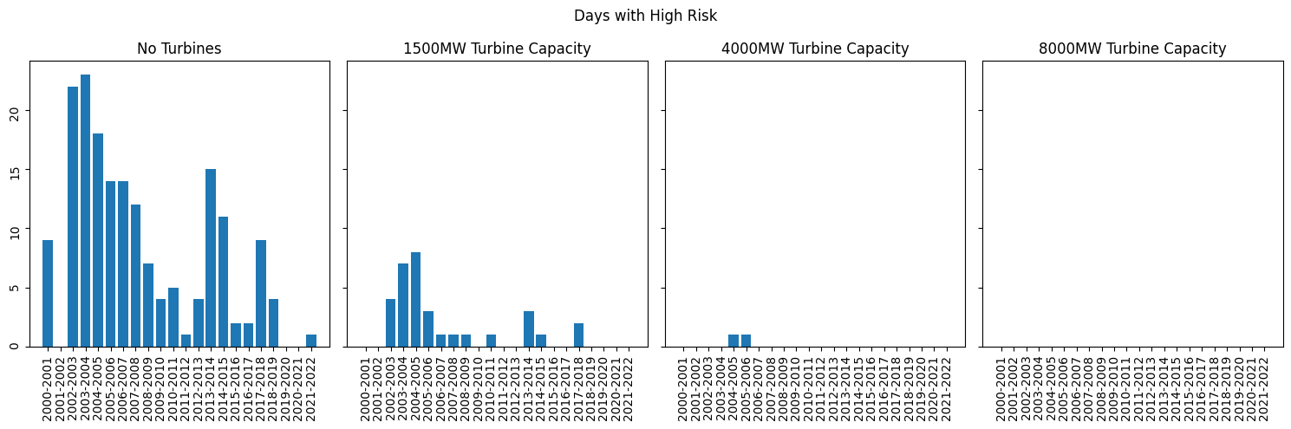
Days of High Risk with Varying Levels of OSW Capacity for Winters 2000 to 2022

Slide 7
Notebook 2:
Non-winter OSW Analysis

Slide 8
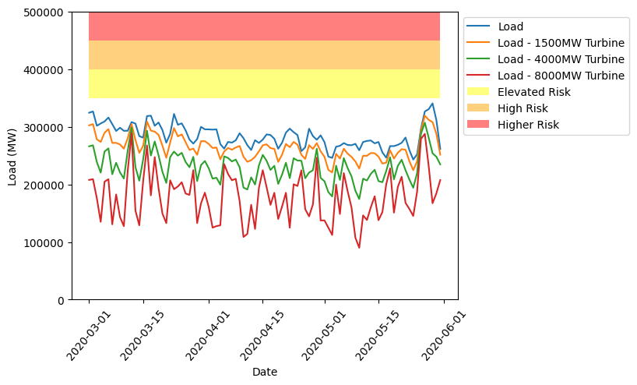
Spring 2020 Load and Loads after Theoretical OSW Installations

Slide 9
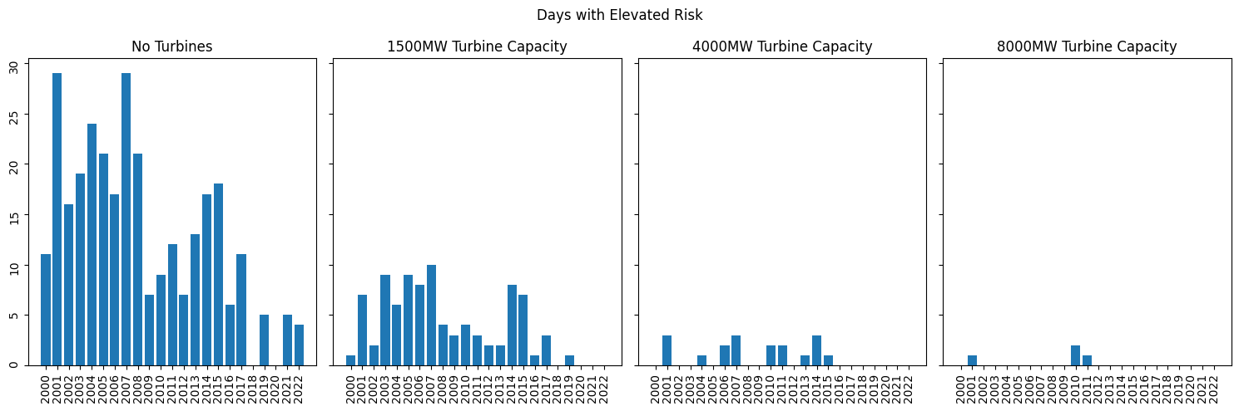
Days of Elevated Risk with Varying Levels of OSW Capacity for Select Non-winter Months 2000 to 2022

Slide 10
Notebook 3: Winter OSW + Solar Analysis

Slide 11
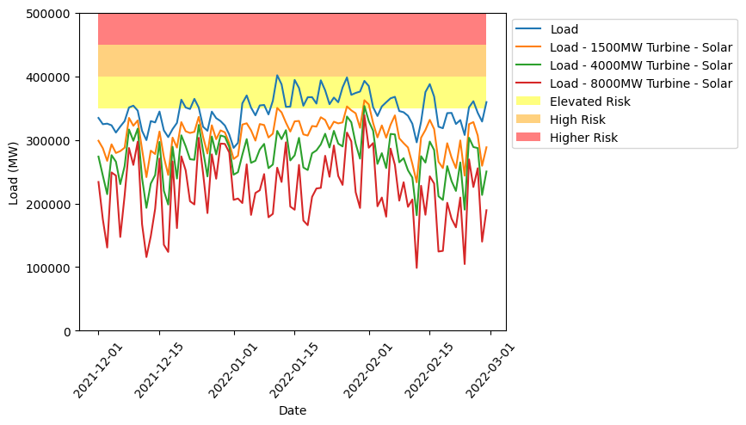
Winter 2021-2022 Load and Loads after Theoretical OSW and Solar Installations

Slide 12
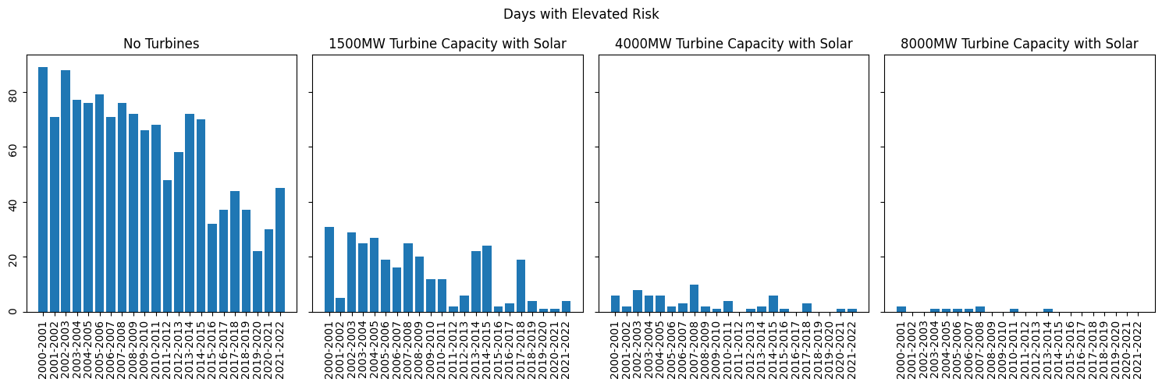
Days of Elevated Risk with Varying Levels of OSW Capacity + Solar for Winters 2000 to 2022

Slide 13
Notebook 4: Winter OSW + Solar Heatmaps by Year

Slide 14
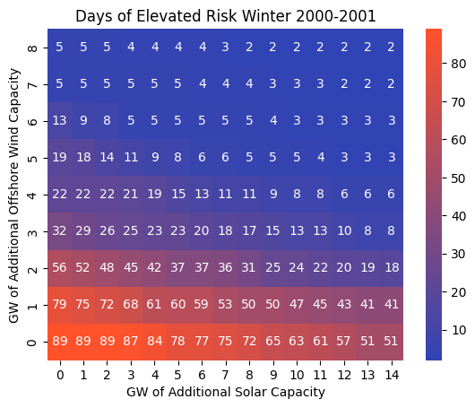
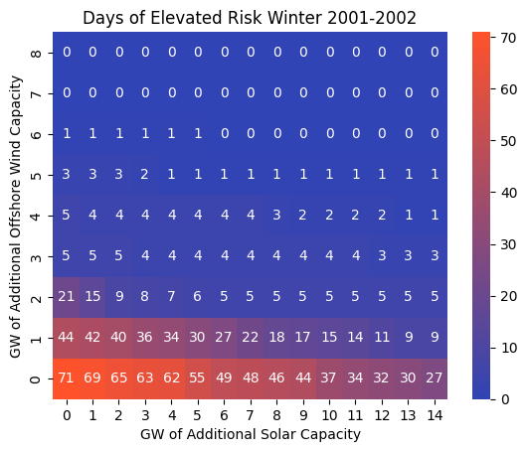

Slide 15
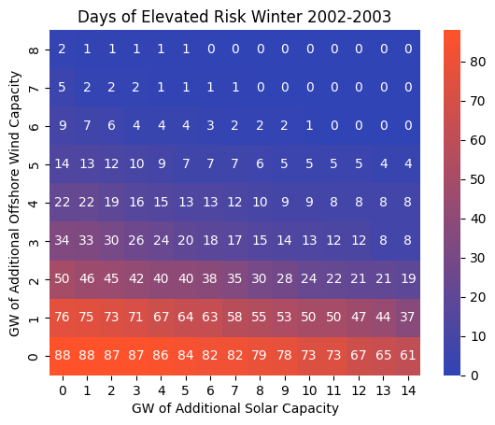
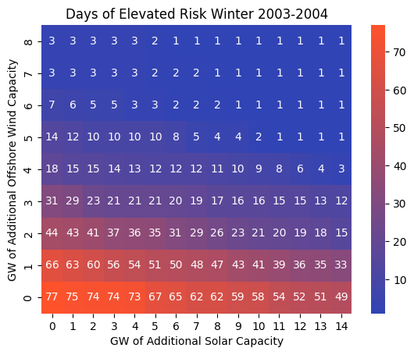

Slide 16
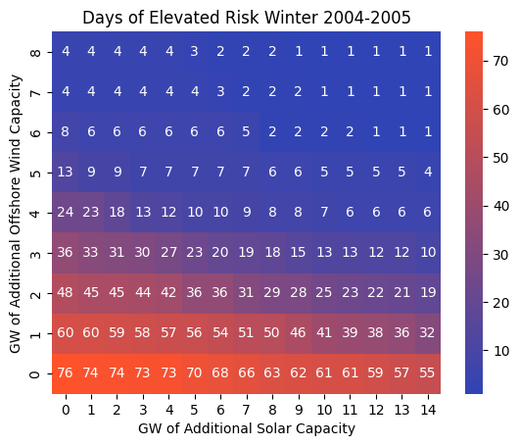
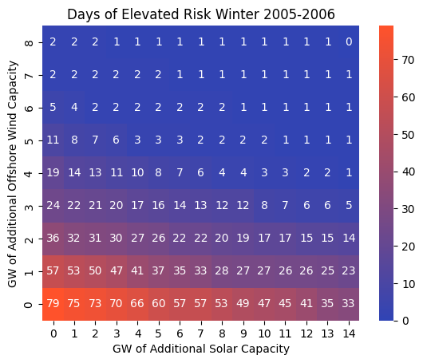

Slide 17
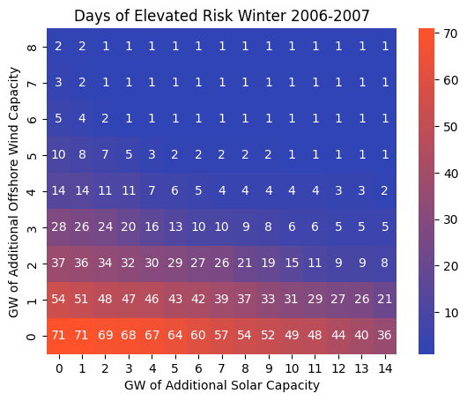
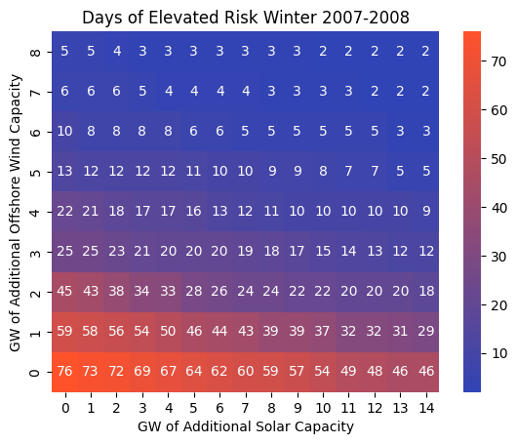

Slide 18
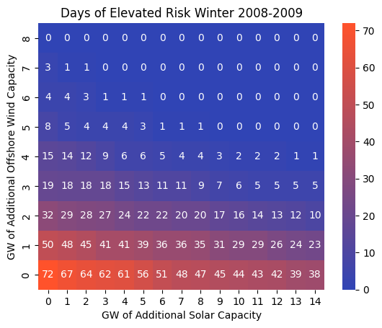
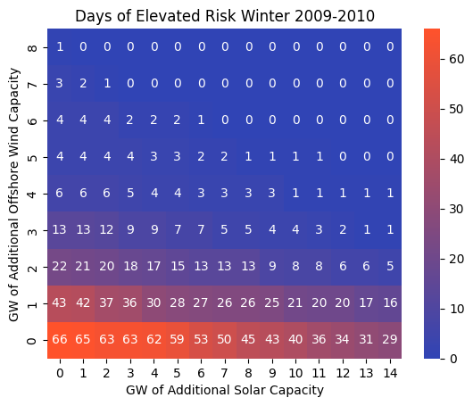

Slide 19
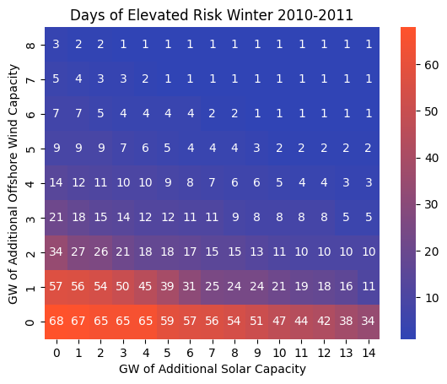
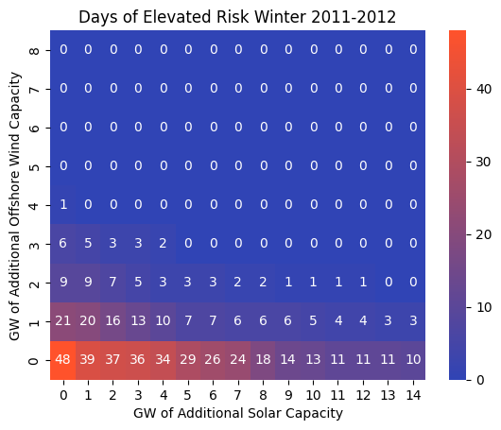

Slide 20
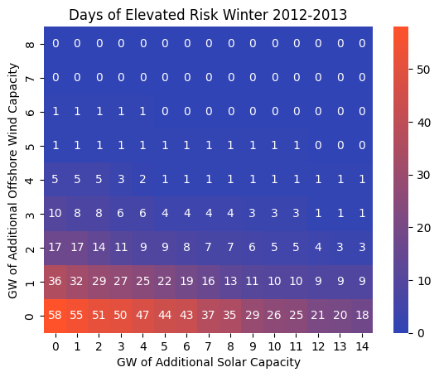
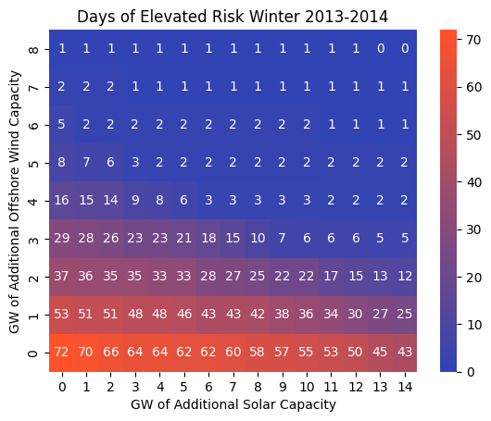

Slide 21
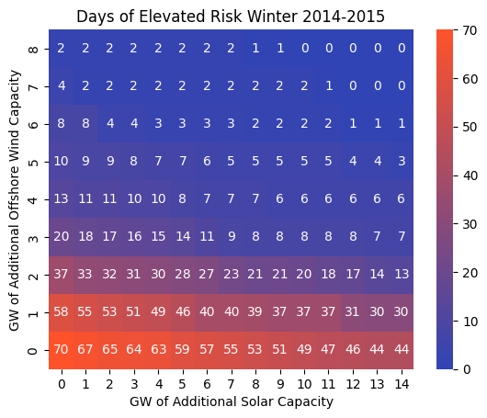
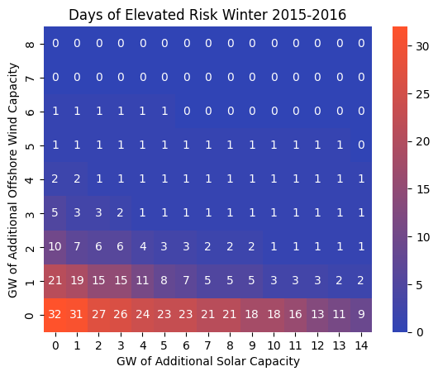

Slide 22
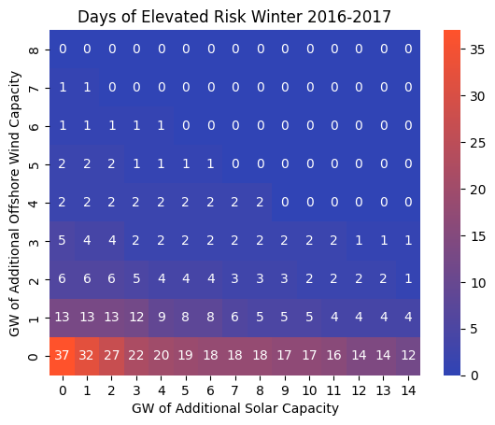
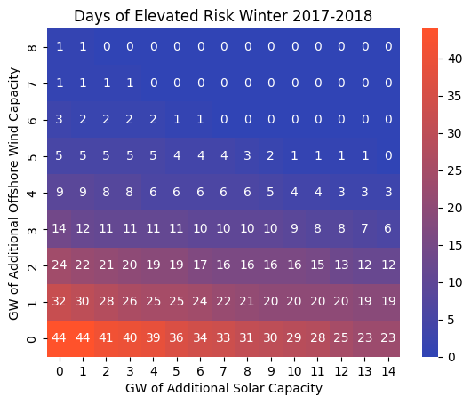

Slide 23
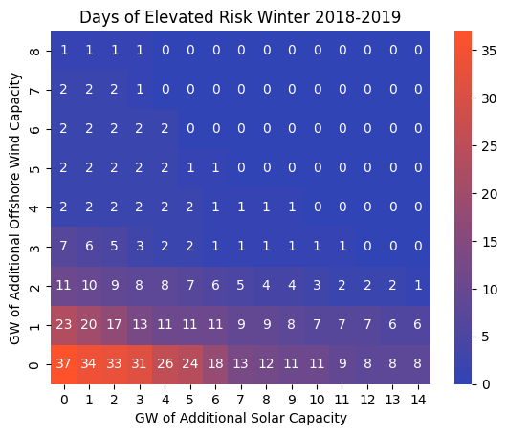
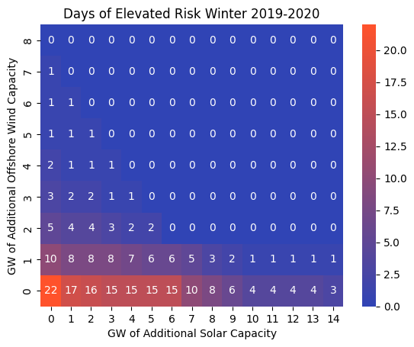

Slide 24
